Slide 1
Solution proposal
Inventory
Management System
V 1.0.0
By:

Slide 2
Executive Summary
The Client is a merchant situated in the Philippines that offers wide range of vehicle lubricant products.
In order to keep track of product inventory across 3 warehouses, the Client is looking for a comprehensive inventory management system to monitor the incoming/outgoing stocks and their stock level.
In the following sections, the solution overview and its implementation plan will be discussed.

Slide 3
Introduction Inventory Management process
Ensuring the Right Quantities, Right Products & Right Time to Buy/Sell

Slide 4




An efficient Inventory management software
Inventory management software aims to increases efficiency, reduce cost and ultimately eliminate risks that will impact business caused by mismanaging your stock inventory.
An efficient system should consist of the following abilities:
Inventory Management System
Setup accurate product info
Lable and tag inventory
Order picking
Monitor inventory in real-time

Slide 5




Inventory management process – How it helps?
A well-designed inventory management process will help your business to make informed decisions on what stocks to replenished, and when is the best time to do it.
The key benefits of having such solutions are highlighted below:
Reduce Human Errors
Inventory management process involved numerous routine tasks that can be easily automated with the help of automated software. Inventory management software perform routine task faster, more accurate and much more efficient, eliminating human errors in the process.
Improves Productivity
Employees will have less repetitive and mundane day-to-day tasks on hand with the help of the system. Furthermore, onboarding a new employee will be much faster with a standard process in place.
Enables Inventory Visibility
Inventory management software produce meaningful data pertaining to your inventories. In time, all data stored within the system will provide insight for you to make data-driven decision for your business, as well as avoiding overselling or overstocking.
Reduce Down-Time
Time is of the essence in business. With real-time data constantly available at your fingertip, you can ensure smooth and continuous flow of goods from you to your customers.

Slide 6
Solution overview key functions and features
The right sets of tools for your inventory management needs

Slide 7
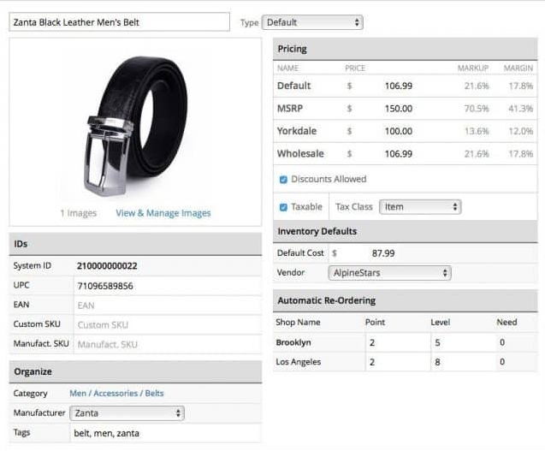
Products Management
You will gain the flexibility to setup and configure your inventory management system according to your business needs with this module.
To ensure accurate inventory management, it is crucial to setup your products with sufficient and specific information for easy tracking. Information should include:
Product name
Cost
Selling price
SKU number
Category
Size/weight/liter or other crucial shipping details
Suppliers or manufacturer name
Product image
Etc...
For example
Notes:
Exclude those with 0 credit limit in the permanent credit limit
Continue from Company A , B and etc

Slide 8
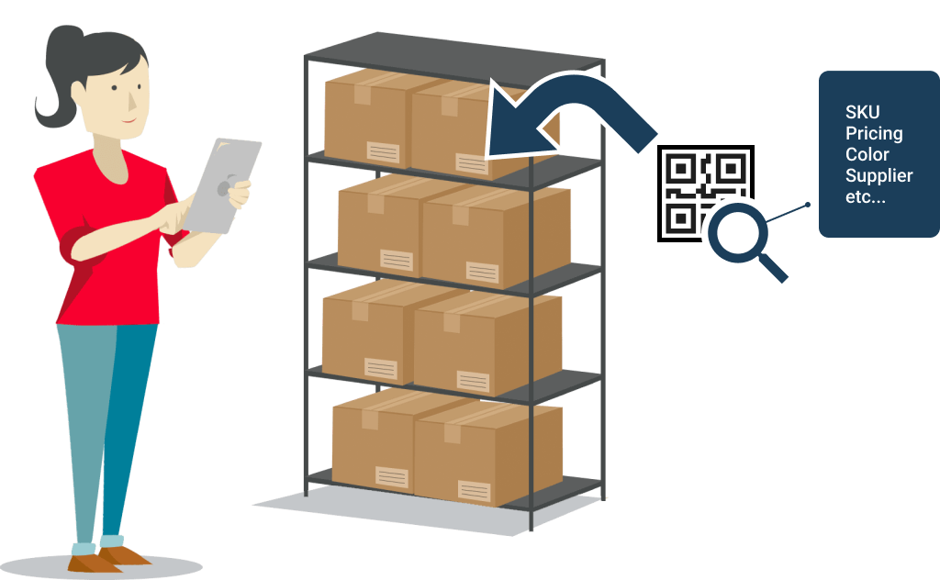
Tag & Label Inventory
QR Code with Product Info
Embed meaningful data into QR code or barcode to accurately define your inventory.
Mobile Phone as QR Scanner
Barcode/ QR code scanning without the need of additional hardware. By leveraging mobile app technology and its camera features, you can retrieve data from the label easily.
Notes:
Exclude those with 0 credit limit in the permanent credit limit
Continue from Company A , B and etc

Slide 9

Order Picking
Scan barcode/QR to pick item from inventory
Simple & Straightforward Picking Process
Fulfill orders by scanning label on the inventory. Pickers are only requiring to pick the right product off the shelf instead of figuring out what's on the shelf.
Wrong Product Alert
System will alert the pickers if they scan the wrong label. This will effectively eliminate wrong product being sent to customers.
Notes:
Exclude those with 0 credit limit in the permanent credit limit
Continue from Company A , B and etc

Slide 10
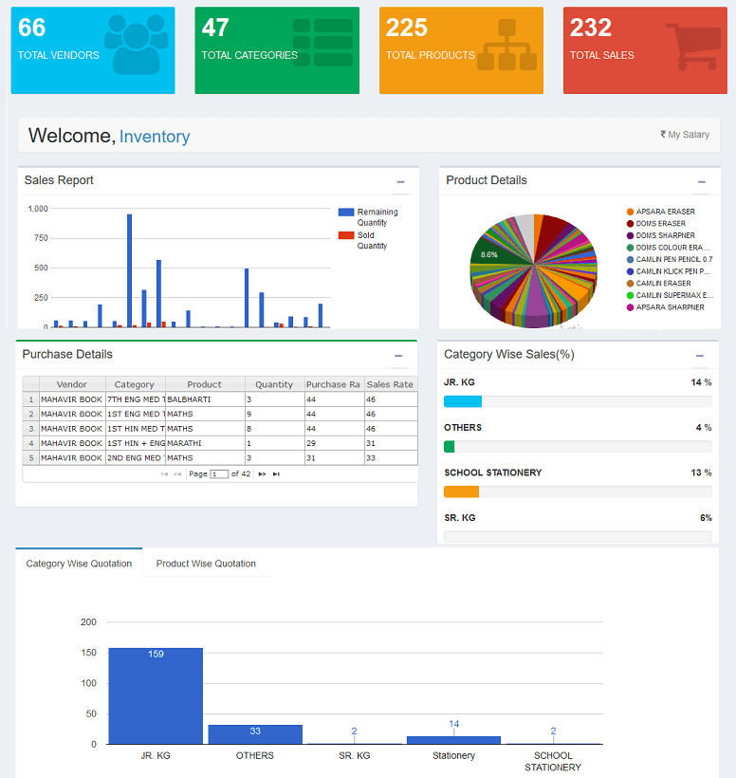
Inventory Tracking
Maximum Visibility
Inventory levels are reflected in real time to maximized stock visibility.
Better User Experience
Data are represented in form of dashboard to better visualize the context of your data. What to display on the dashboard can be customized based on your business requirements.
For example
Notes:
Exclude those with 0 credit limit in the permanent credit limit
Continue from Company A , B and etc

Slide 11
Project plan

Slide 12
Work breakdown
{{get from vendor}}
Notes:
Exclude those with 0 credit limit in the permanent credit limit
Continue from Company A , B and etc

Slide 13
Estimated timeline
{{get from vendor}}
Note
The given estimated timeline is based on our projected resource planning. Actual timeline might differ based on actual resource availability when the project is confirmed.
Please highlight any foreseeable deadline in order to optimise the available resources.
The timeline is based on assumption that the client is ready to provide necessary inputs for the project team.

Slide 14
Estimated costing
Description | Cost (RM)
TOTAL (RM)
Cost should include: - Implementation for 1 head office, 3 warehouse/distribution center.
- annual/monthly maintenance and support fee for 2 year contracts.
- barcode scanner or mobile app scanner.
{{get from vendor}}
*tax not included

Slide 15
Beyond Version 1.0
Improvement for better future

Slide 16




Possible upgrades
Further develop and improve the system with upgrades and automation, including:
Inventory Management System
v1.0
Setup accurate product info
Lable and tag inventory
Order picking
Monitor inventory in real-time
v2.0
Generate PO/DO
Automatic Stocktaking
Automatic stock level alert
Integrate with accounting software

Slide 17
Possible upgrades Cont.
Possible area to explore in v2.0 onwards:
Generate PO/DO
Create and issue PO/DO via the system to optimize your business processes. Use templatized document formats for recurring purchases.
Automatic Stocktaking
System will be able to automatically generate stock taking reports by calculating your quantity on hand on set interval. This will eliminate human counting errors and employees can focus on cross checking to ensure minimal error.
Stock Level Alert
Inventory control automatically alerts your managers when the item in stock falls under or exceeds a predefined threshold. Notification will be sent to your designated PIC to ensure the right info is conveyed to the right person.
Integration with 3rd Party Accounting Software
Make the system “communicate” with your accounting system instead of changing what’s already working. System will be connected with API to sync latest data when necessary.

